Slide 1
Introduction to SQL for Programmers
Dr. Abhijit Dasgupta
District Data Labs

Slide 2
SQL
SQL stands for Structured Query Language
It is a common standard language for many Relational Database Management Systems (RDBMS)
MySQL
Postgresql
SQLite
Microsoft SQL Server (uses an extended version called T-SQL)

Slide 3
SQL
SQL is a declarative language
You tell it what you want it to do
Don’t worry (necessarily) about order of implementation of commands
SELECT first_name, last_name FROM employees WHERE salary > 100000

Slide 4
SQL
SQL has various commands for different operations
SELECT
FROM
WHERE
GROUP BY
HAVING
UNION
ORDER BY
JOIN

Slide 5
Why databases?

Slide 6
Why choose to use a database
Databases can handle very large datasets
Databases are scalable
Databases are concurrent, i.e., multiple users can use the same data at the same time
You can relate data from different tables (datasets) using joins

Slide 7
Why choose to use a database
You have large data from which you need to query and elicit information quickly
You have relational data
You have donors and recipients of aid, and characteristics of each type in separate datasets

Slide 8
Personal experience
I’m primarily a R and Python user, but some Stata for consulting
All these software requires data to fit into RAM
If data fits into RAM, R and Python are often quite fast and efficient
If data doesn’t fit into RAM, I use a database to munge and aggregate data, then import reduced data into R/Python
MySQL or SQLite, primarily

Slide 9
Personal Experience
Working with several datasets from government healthcare database
Some datasets are over 10 million records
Different aspects of patient experience in different datasets (tables)
Need to combine, filter, and aggregate data
R vs RDBMS
RDBMS is no faster than R for simple summaries and aggregations
For data munging and joining, it’s several times faster
Retrieving the query results in chunks makes things even quicker

Slide 10
Personal Experience
Significant time to load data into RDBMS (maybe overnight)
However, significant savings in time on multiple analyses
Since RDBMS is on disk in common location, can access it from anywhere and work on it

Slide 11
Setting up your environment

Slide 12
Environment
Windows (7, 8, 10)
Microsoft SQL Server (RDBMS) residing in cloud on Microsoft Azure
Or locally, using SQL Server /SQL Server Express
Microsoft SQL Server Management Studio (SSMS)
R version 3.5 running in RStudio
Anaconda Python 3.5
Stata 14

Slide 13
Drivers
ODBC (Open Database Connectivity) is a common means for communicating with different RDBMS
Microsoft provides ODBC drivers for Windows, Linux and Mac OSX
https://docs.microsoft.com/en-us/sql/connect/odbc/download-odbc-driver-for-sql-server
You need to download and install a driver on your machine to connect with Azure SQL Server
Check with IT

Slide 14
ODBC
You can use ODBC to connect with Excel, Access, as well as a host of SQL-based databases
It’s often one of the faster ways to extract data out of Excel
It gives a common language (API) to connect with different databases
Basically you learn it once and use it in different places

Slide 15
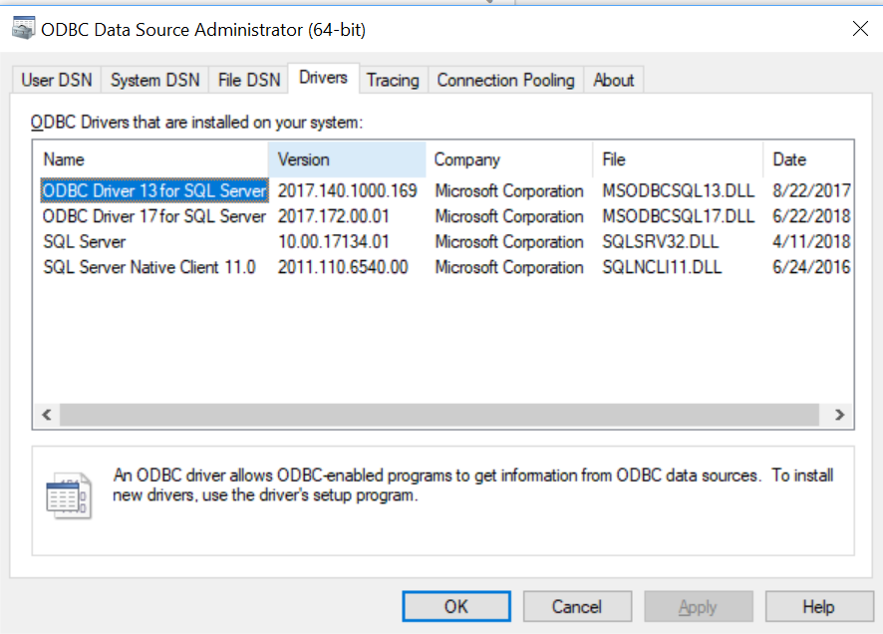
Drivers

Slide 16
DSN
A Data Source Name is a shortcut to access a data source using a ODBC driver
Its very useful if you have a database you’ll access often
The information stays stored on your computer

Slide 17
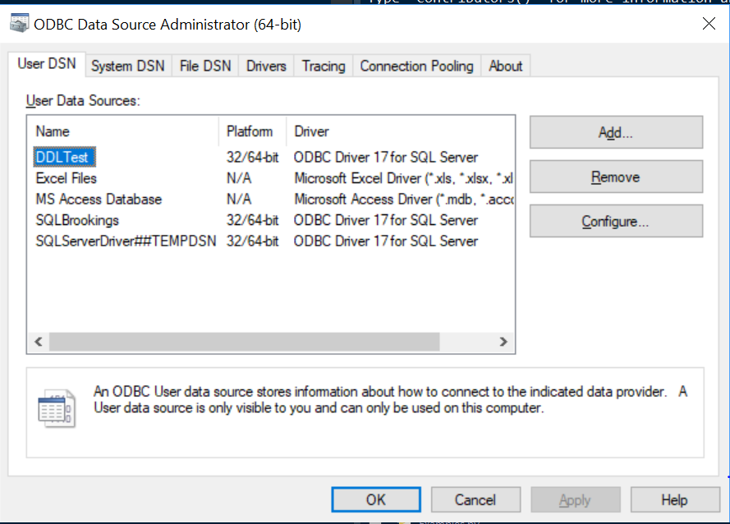
DSN

Slide 18
DSN

Slide 19
DSN

Slide 20
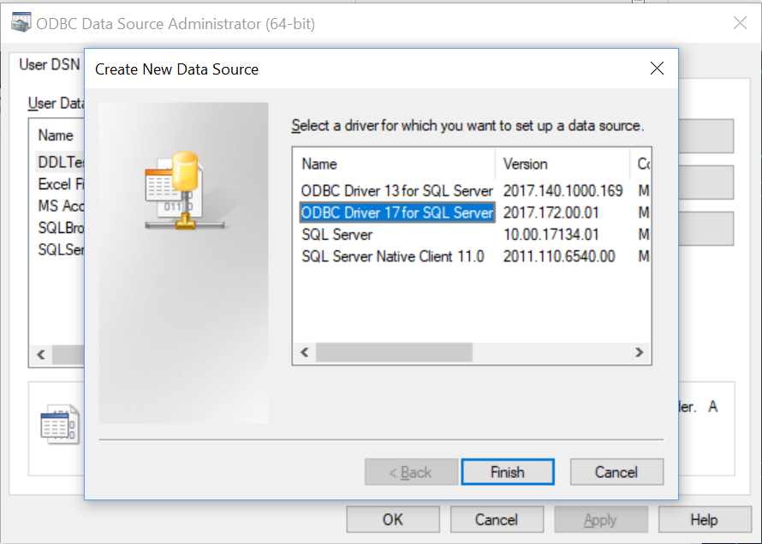
A new DSN

Slide 21
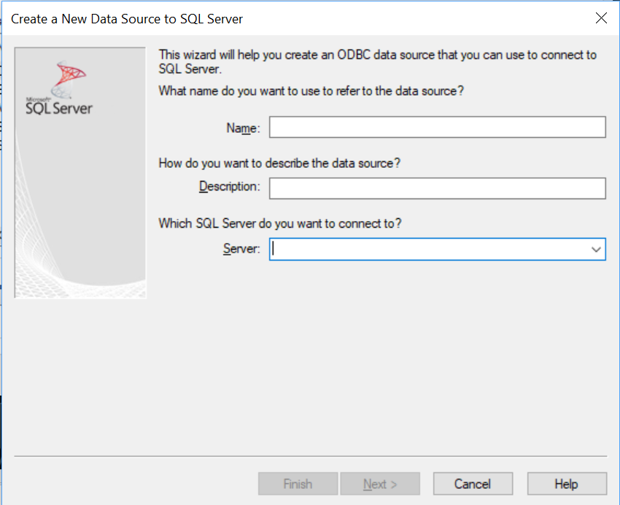
A new DSN

Slide 22
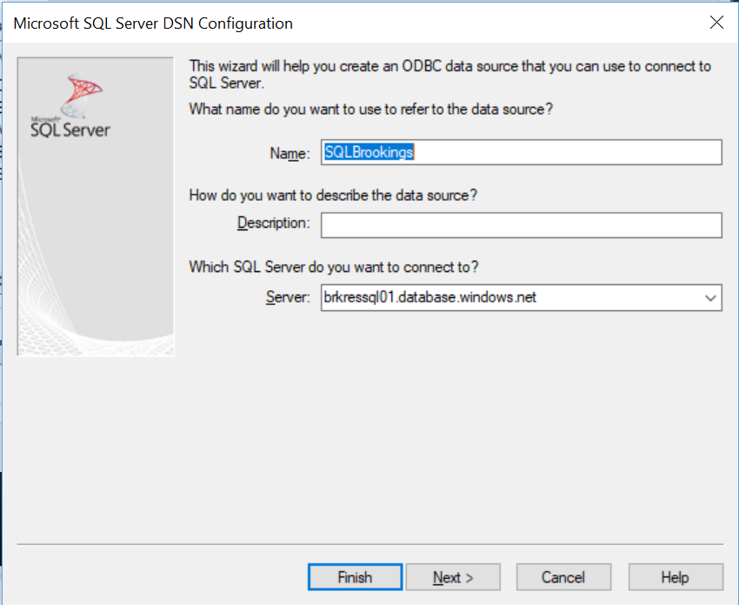
A new DSN

Slide 23
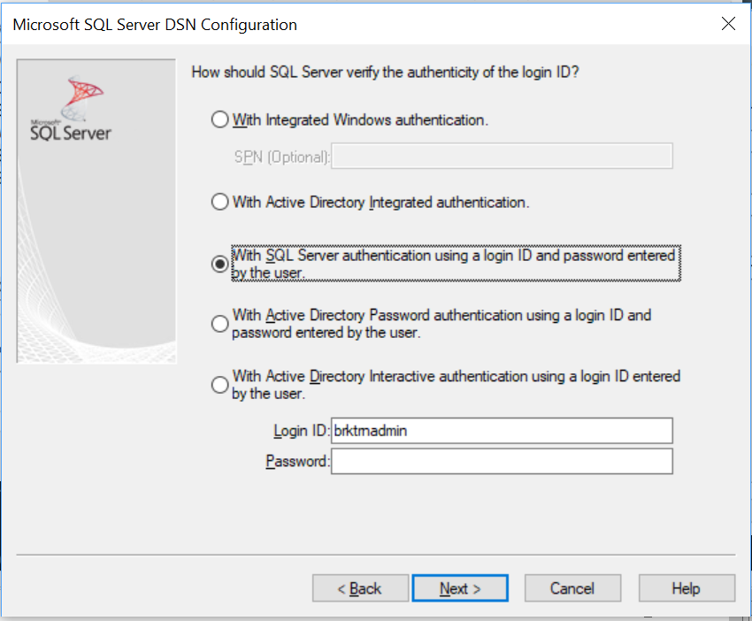
A new DSN

Slide 24
Microsoft sql server management studio

Slide 25
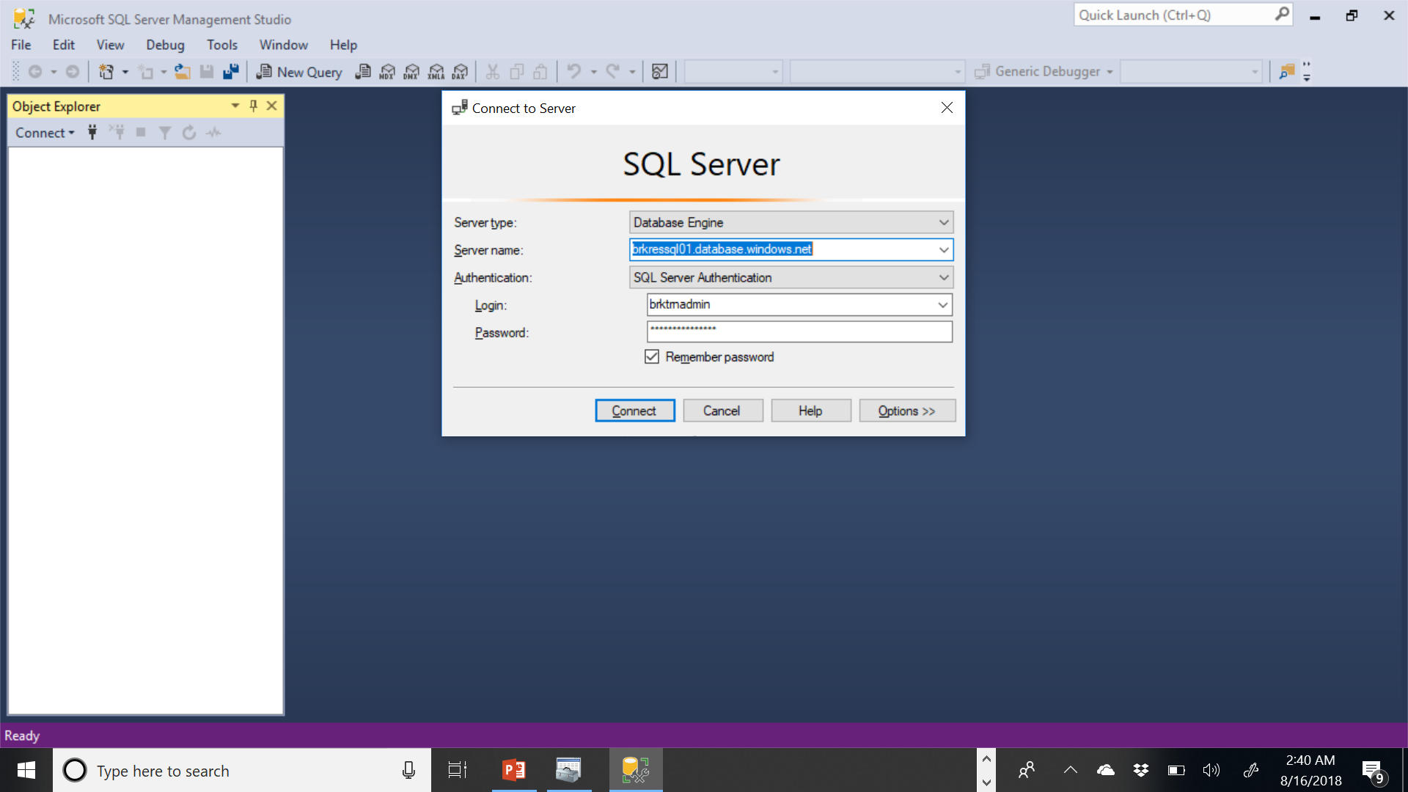
SSMS

Slide 26
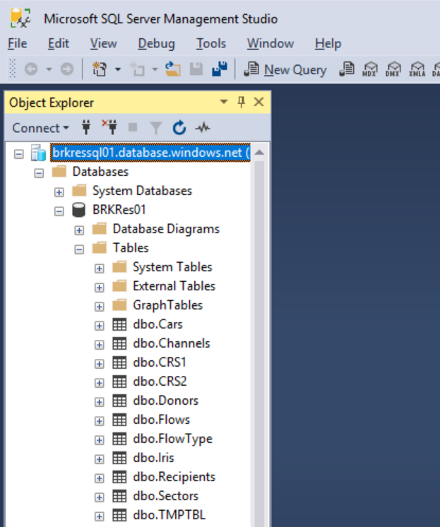
SSMS
Shows existing databases
Shows existing tables

Slide 27
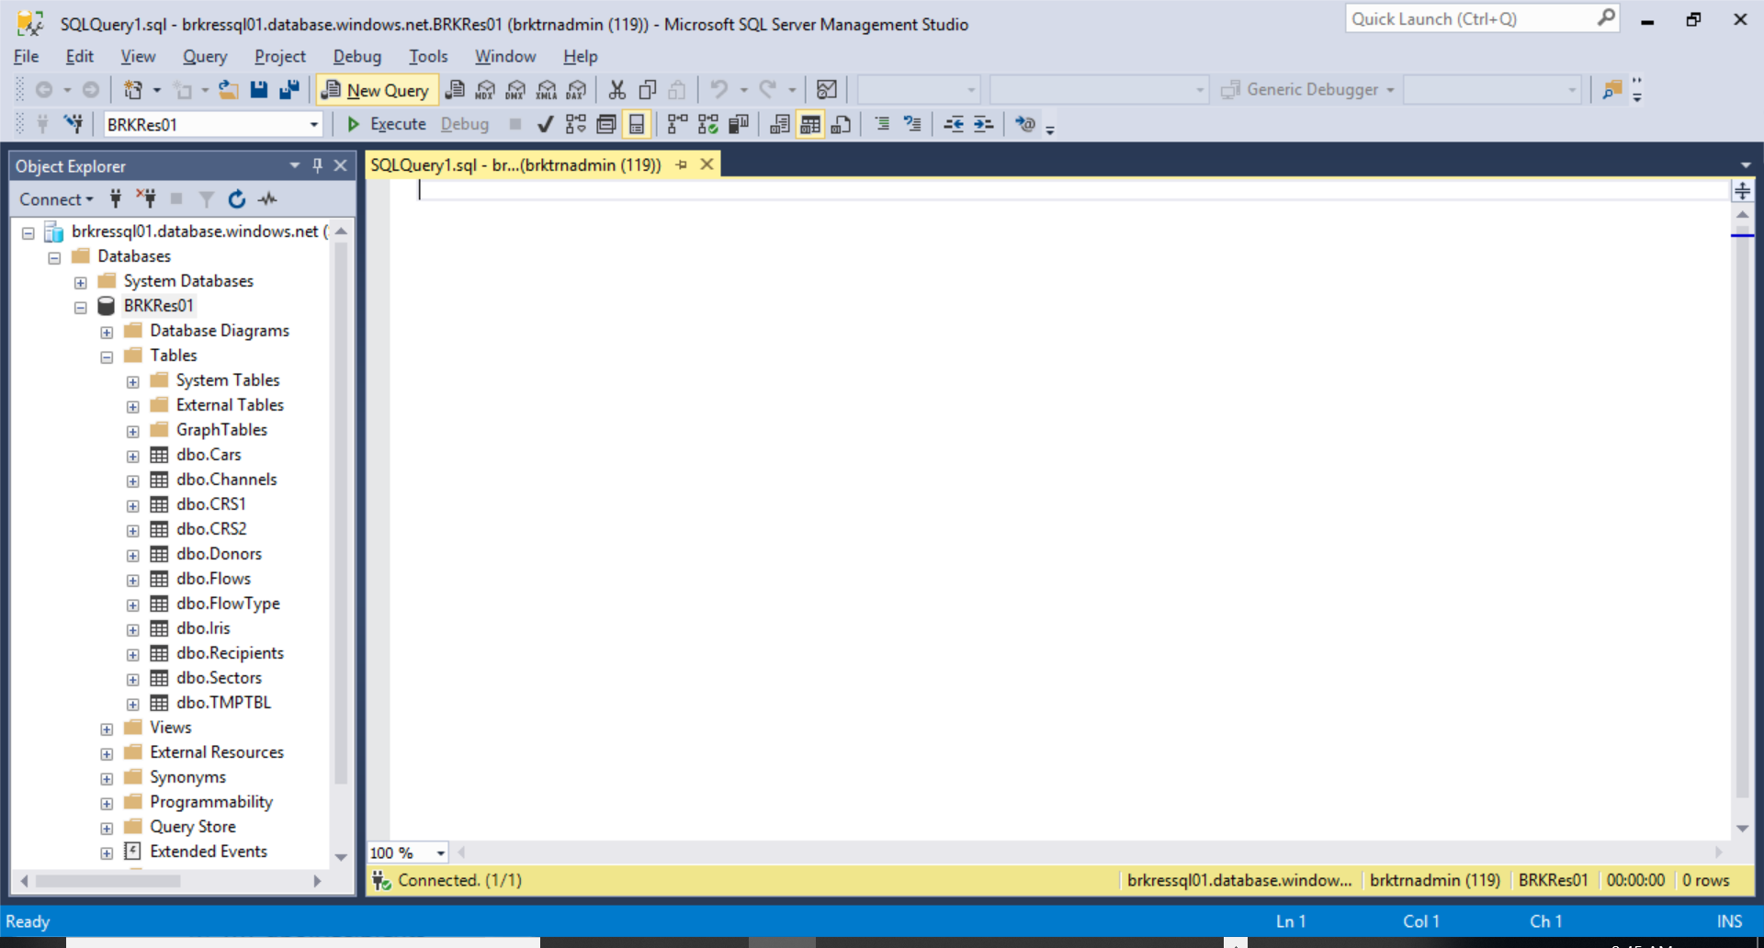
Querying the database

Slide 28
Using SQL for querying the database
The basics

Slide 29
Sample data
Book examples
Cars, Iris
Creditor Reporting System data from OECD
https://stats.oecd.org/viewhtml.aspx?datasetcode=CRS1&lang=en
Split into coded data, and separate tables explaining the codes

Slide 30
select
Selects fields (columns) from table
Can be used to summarize data in a particular field
Can be used to limit the number of rows of output

Slide 31


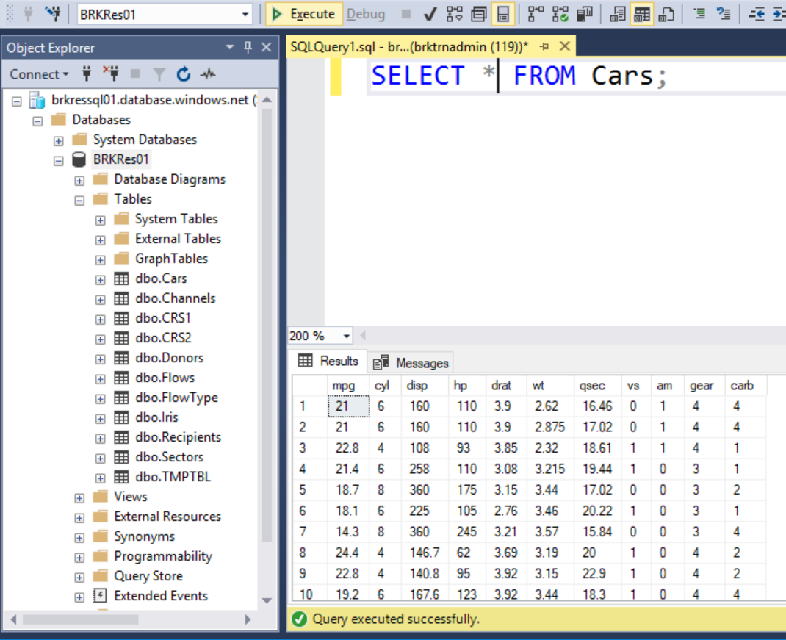
Extract all columns

Slide 32
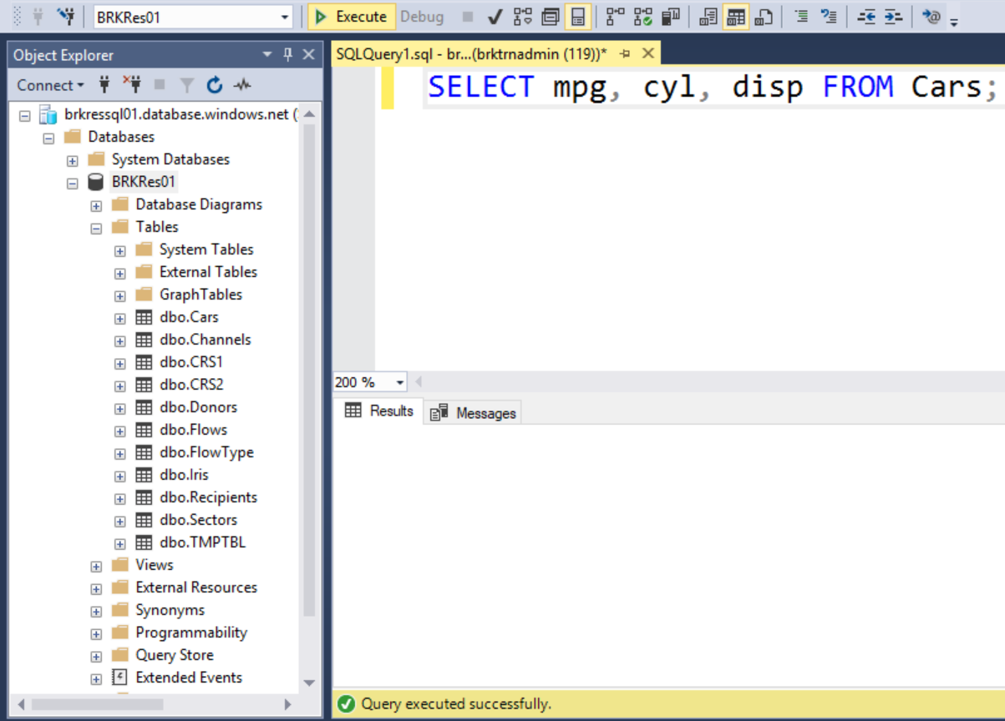
Extract certain columns

Slide 33
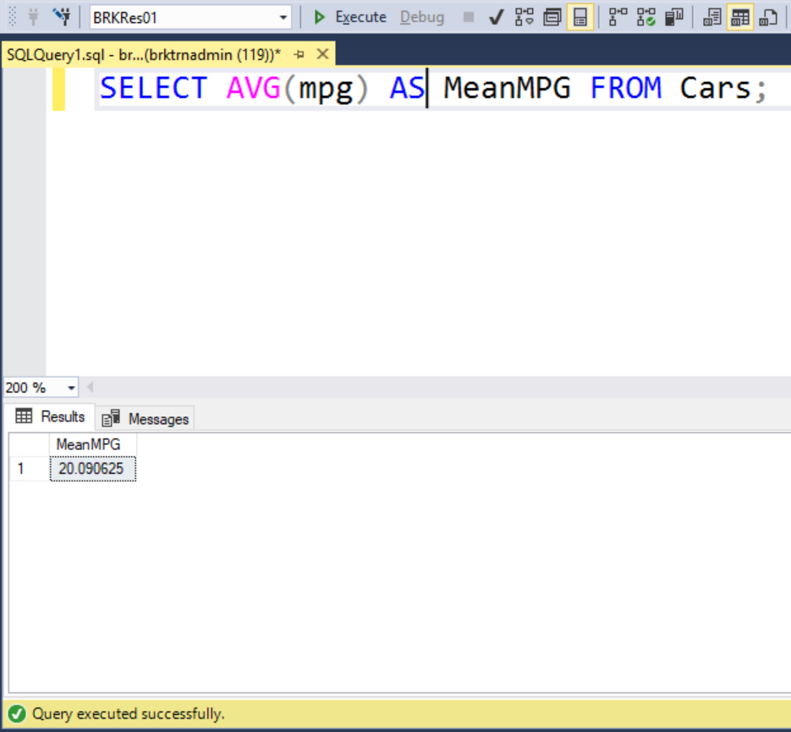
Summarize data in a column

Slide 34
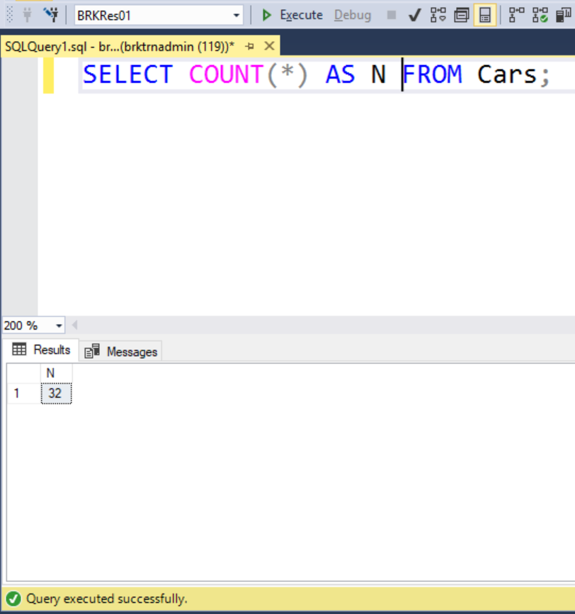
Find the number of observations

Slide 35
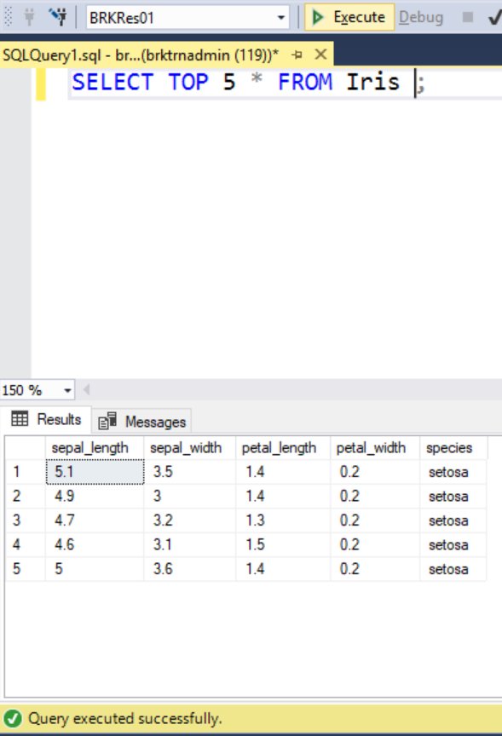
Limit numbers

Slide 36
where
Adds conditions on the data
Subset/Filtering
Works in conjunction with SELECT and other verbs
Can use numeric comparisons (=, >, <)
Can use string pattern matching (=, LIKE, IN, NOT)
https://docs.microsoft.com/en-us/sql/t-sql/language-elements

Slide 37
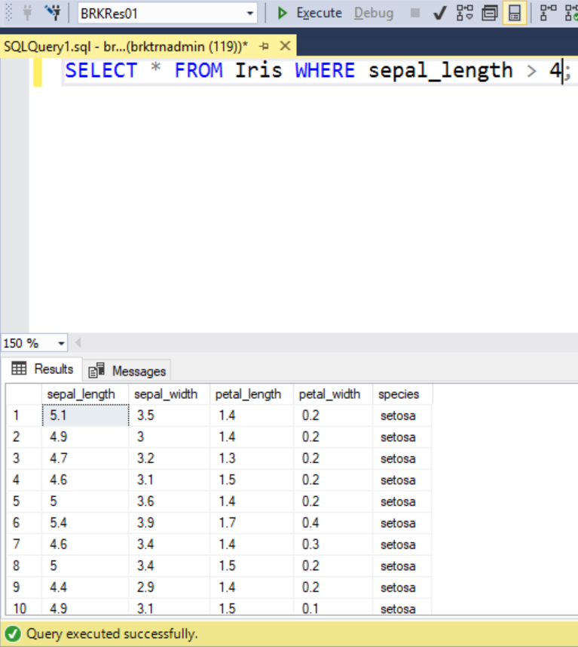
where

Slide 38
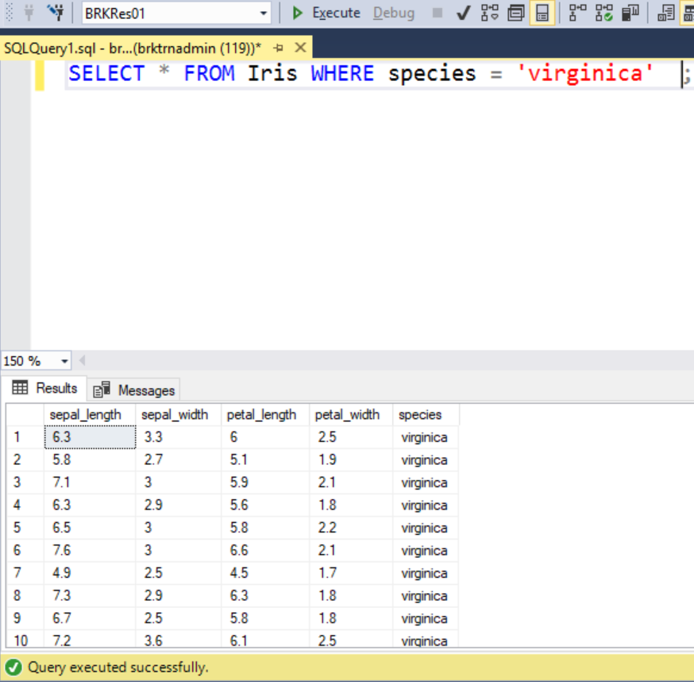
where

Slide 39
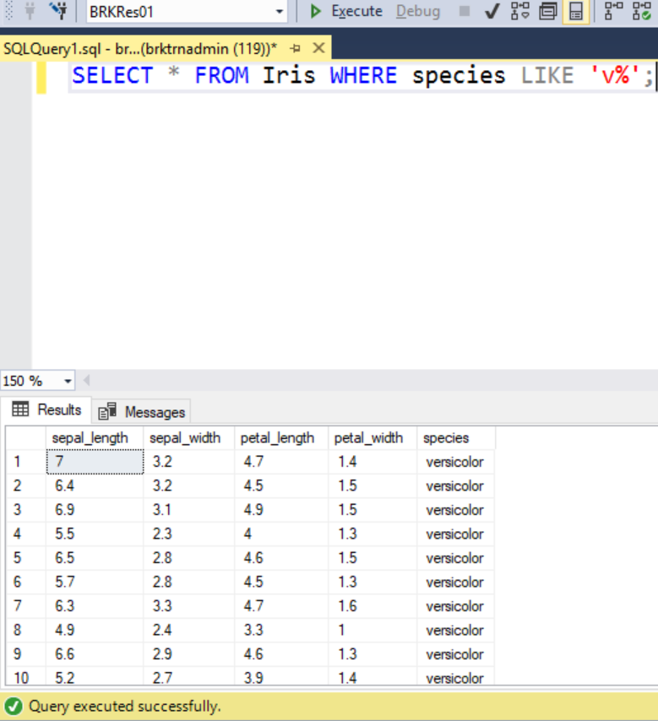
where

Slide 40
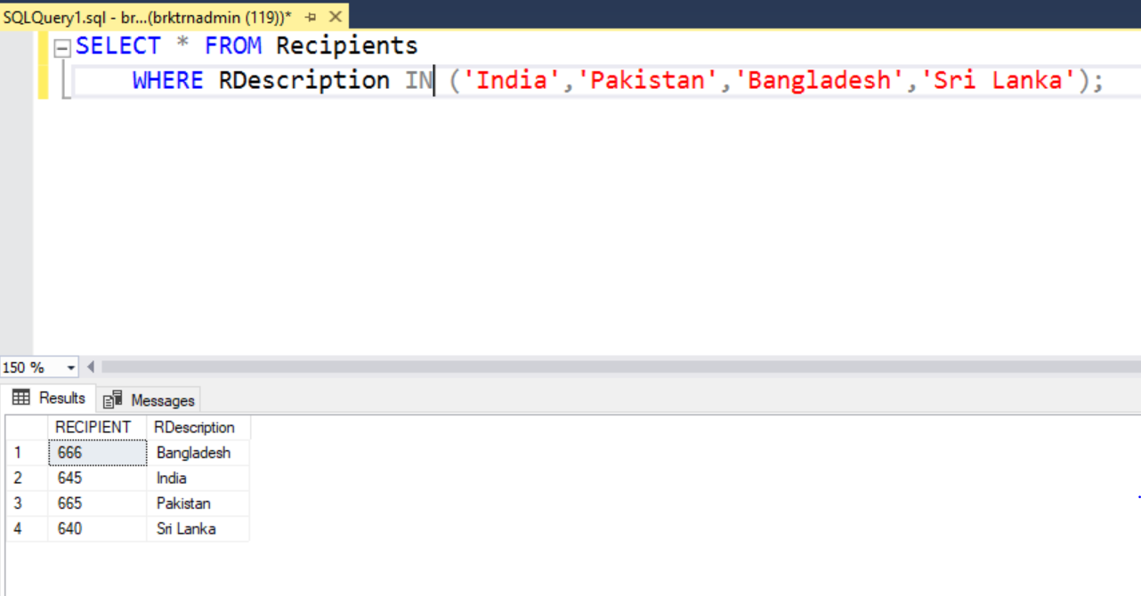

Slide 41
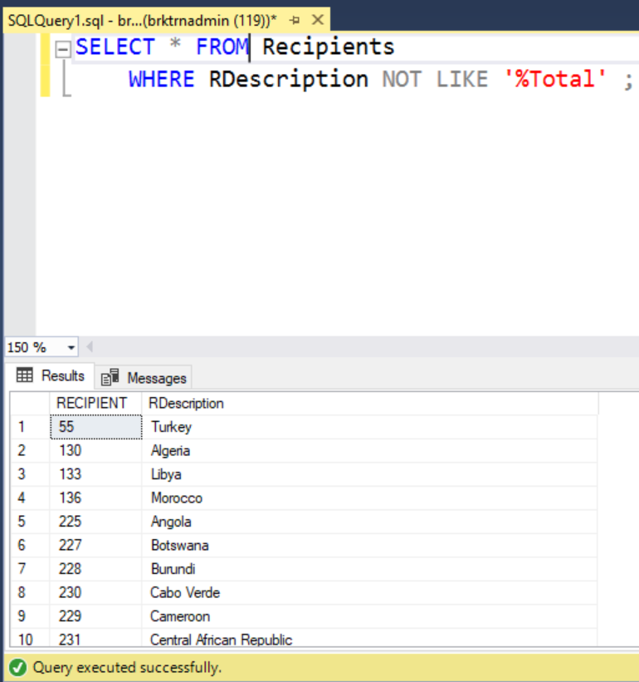
Gives us the individual countries

Slide 42
Group by
Summarizing data by groups
Split-apply-combine
MapReduce

Slide 43
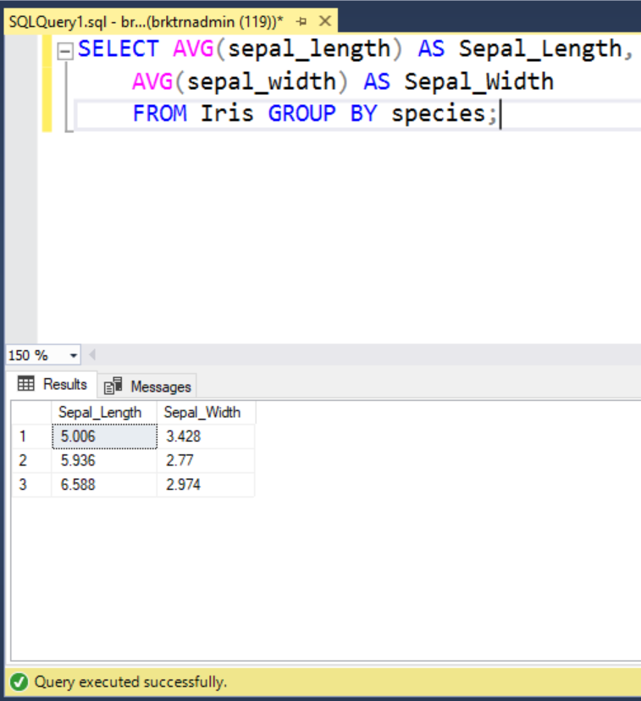
Group by

Slide 44
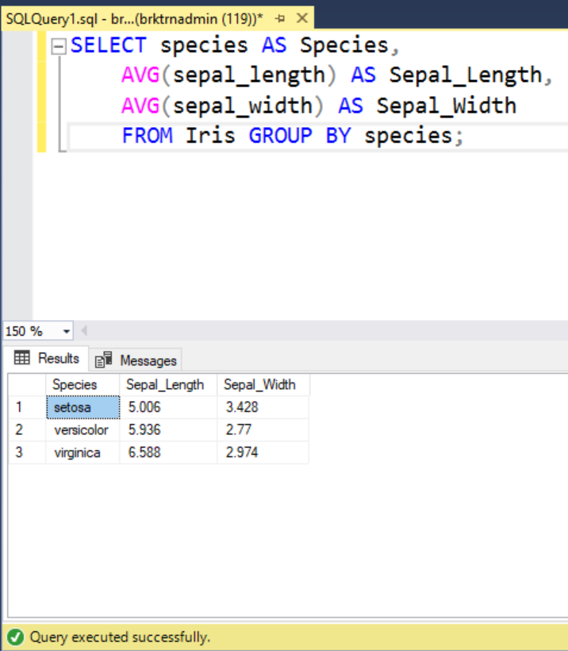
Group by

Slide 45
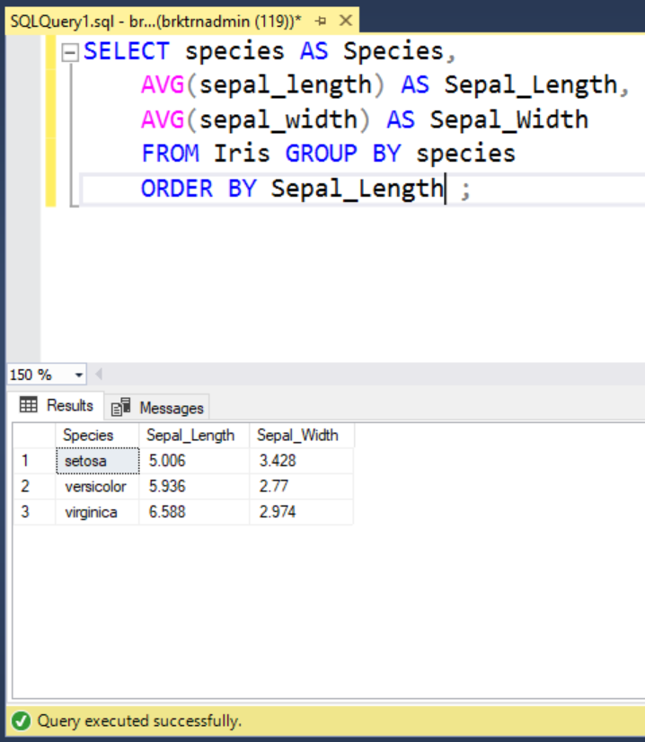
ORDER BY

Slide 46
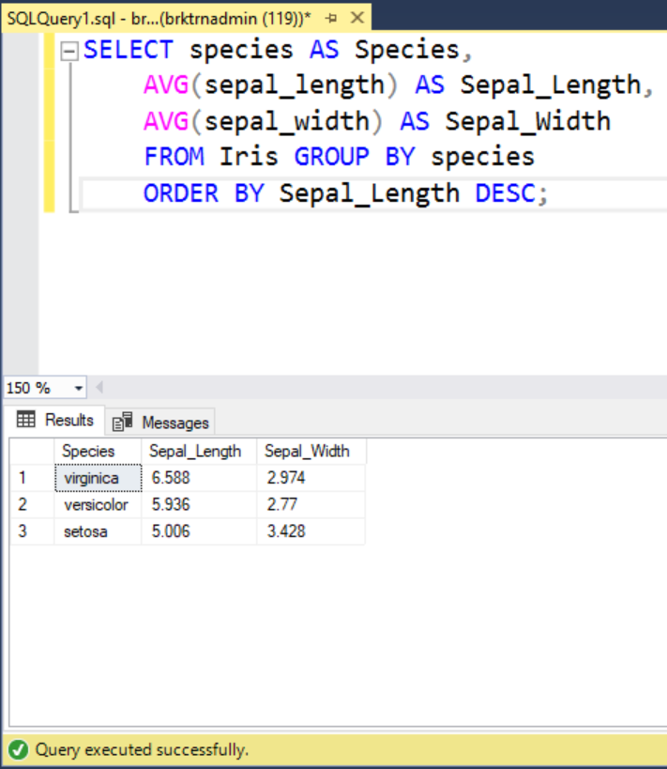
ORDER BY

Slide 47
joins

Slide 48
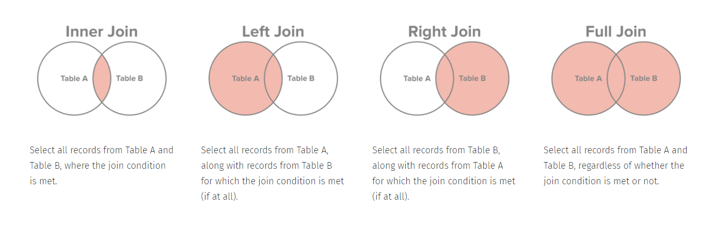
http://www.sql-join.com/sql-join-types/
http://www.sql-join.com/sql-join-types/

Slide 49
Creating New tables
CREATE TABLE (Define a table)
ALTER TABLE (Change the table definition)
DROP TABLE (Destroys the table and its definition)
You’d almost never create a table by hand the way we’re about to
However, SQL backups store their data in this form
Makes for rather big backup files

Slide 50
Creating New tables
CREATE TABLE CUSTOMERS(
ID INT NOT NULL,
NAME VARCHAR (20) NOT NULL,
AGE INT NOT NULL,
ADDRESS CHAR (25) ,
SALARY DECIMAL (18, 2),
PRIMARY KEY (ID));
Variable name
Variable type
Constraint
CREATE TABLE POC(
ID INT NOT NULL,
NAME VARCHAR (20) NOT NULL,
POC VARCHAR (20) NOT NULL,
PRIMARY KEY (ID));

Slide 51
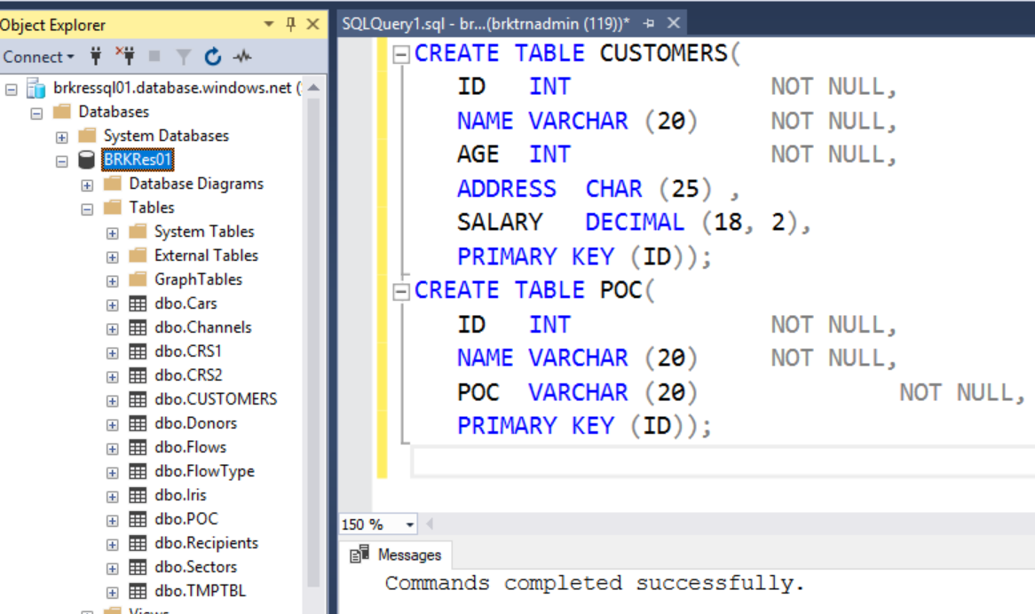



Slide 52
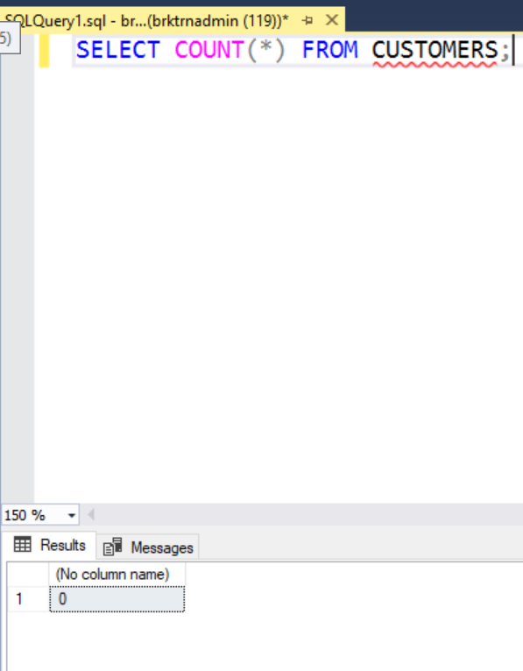
The tables have no data in them yet

Slide 53
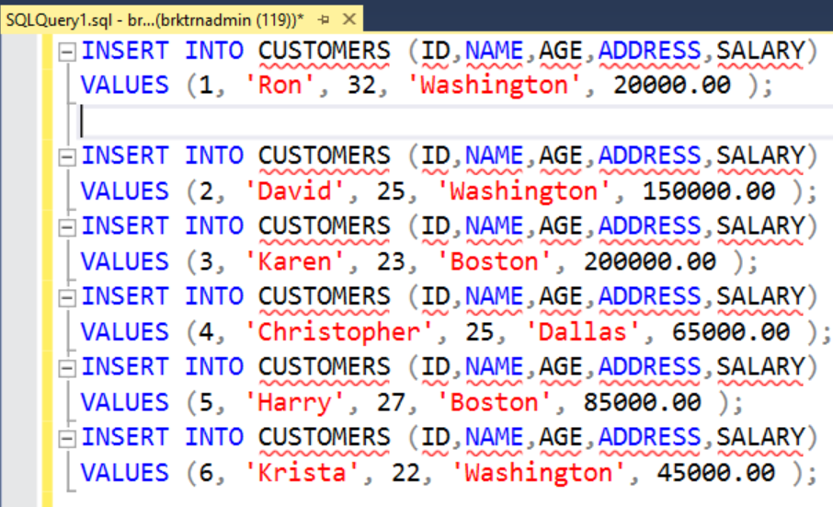
Adding data to tables
INSERT INTO <table name> (<column names>) VALUES(<values>)

Slide 54
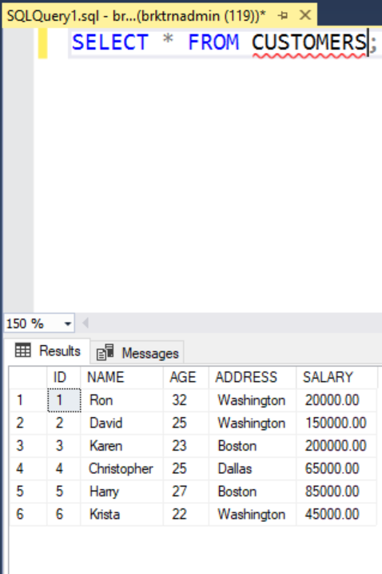
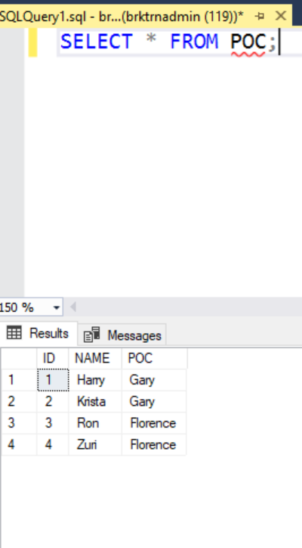

Slide 55
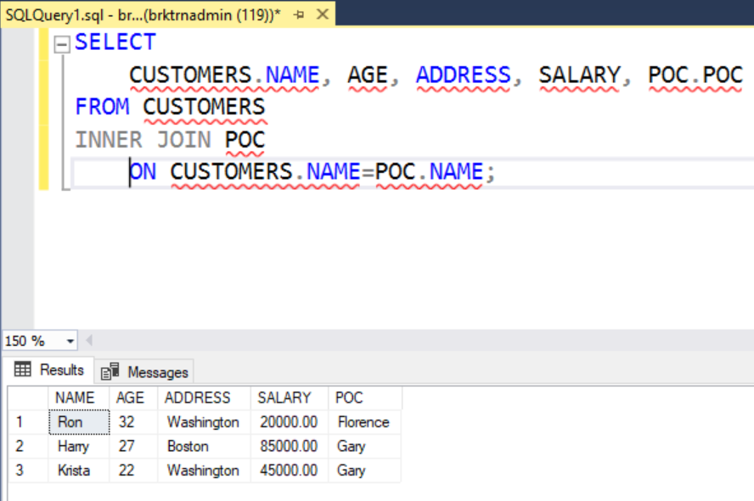
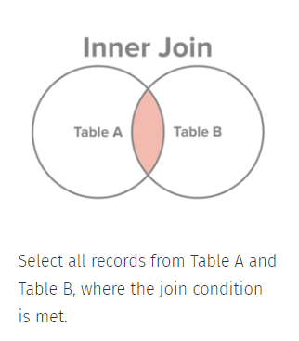

Slide 56
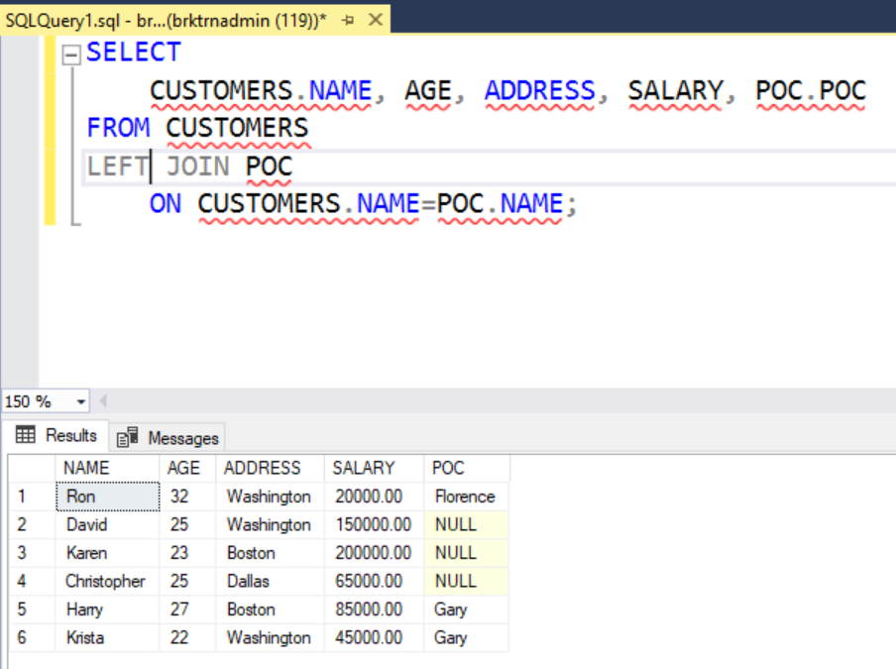
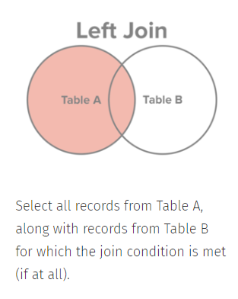

Slide 57
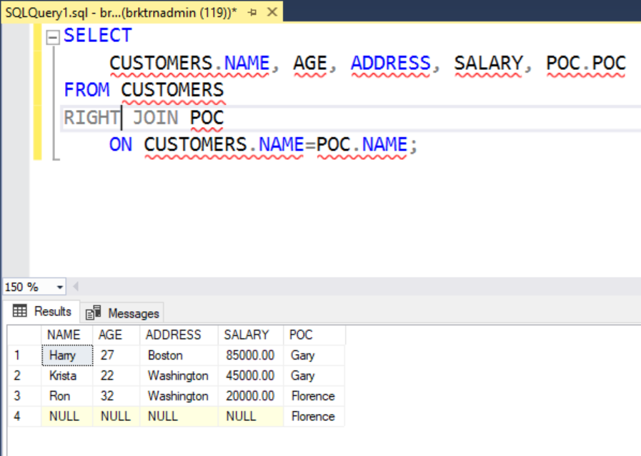
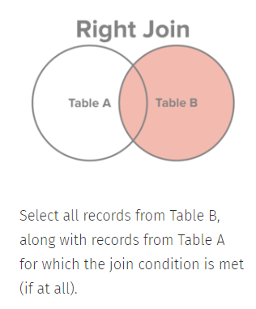

Slide 58
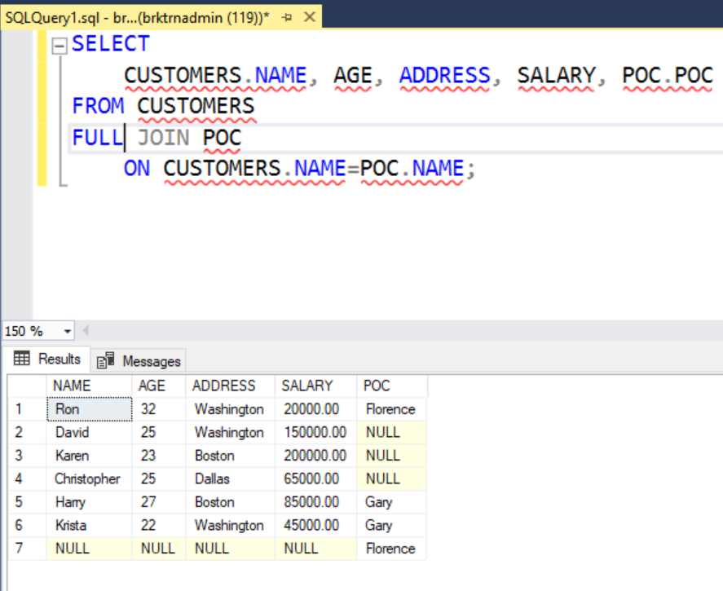
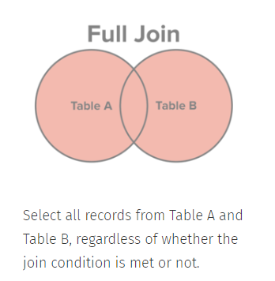

Slide 59
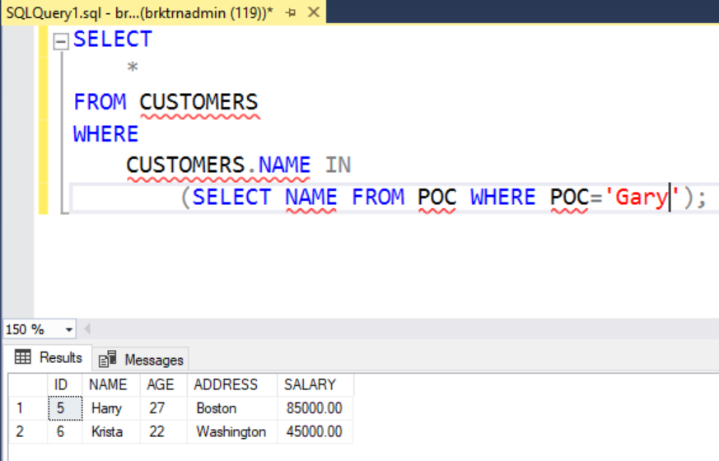
Semi join
Take all rows of Table A which have something in common with some property of Table B

Slide 60
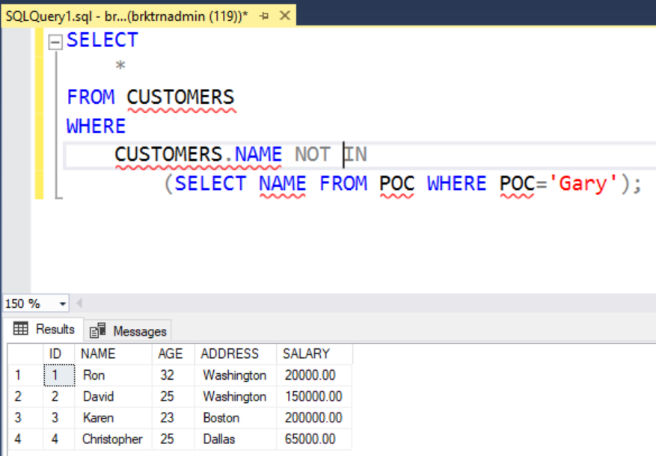
anti join
Take all rows of Table A which do not have something in common with some property of Table B

Slide 61
vIEWS

Slide 62
vIEWS
Views are stored queries that we have an interest in, even if the source data changes
They operate something like tables, but take longer since the query has to be run first, and then operations on the resulting table take place
CREATE VIEW
ALTER VIEW
DROP VIEW

Slide 63
Putting it together

Slide 64
Problem
Find the total amount of money committed by the United States to India each year between 2008 and 2016

Slide 65
Structure of database
One table with numerical coding of variables, containing the value of commitments from Donor to Recipient (CRS1)
Separate tables with codes and descriptions for Donors, Recipients, Sectors
Principle: Each table should contain only one kind of data/relationship
Principle: Searching over text is expensive, so keep it out of the really big table

Slide 66
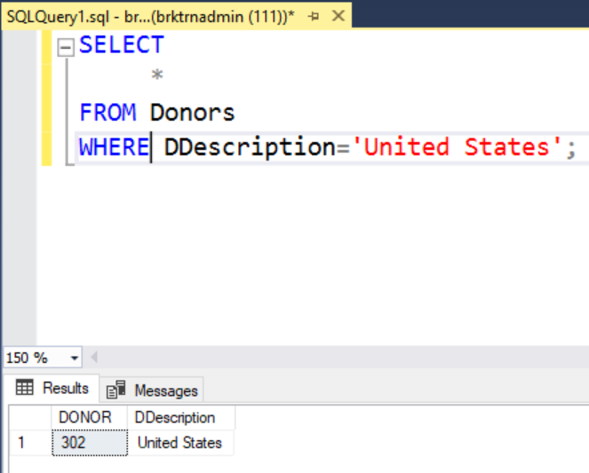
Find Donor code for USA

Slide 67
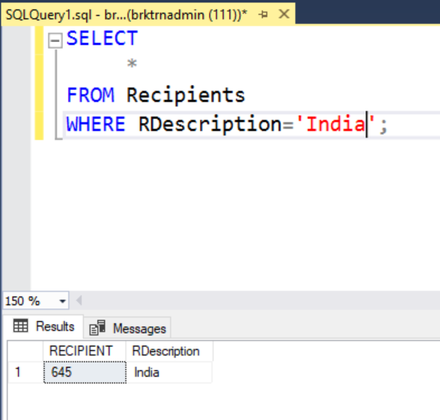
Find code for india

Slide 68
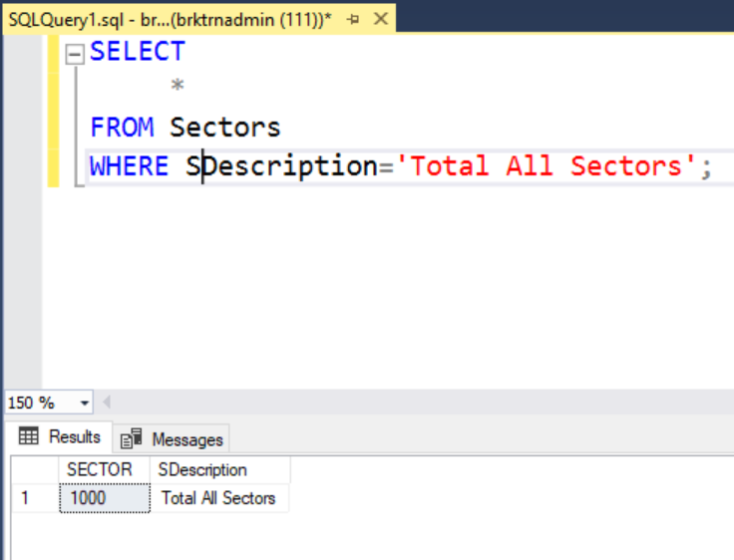
Find code for all sectors

Slide 69
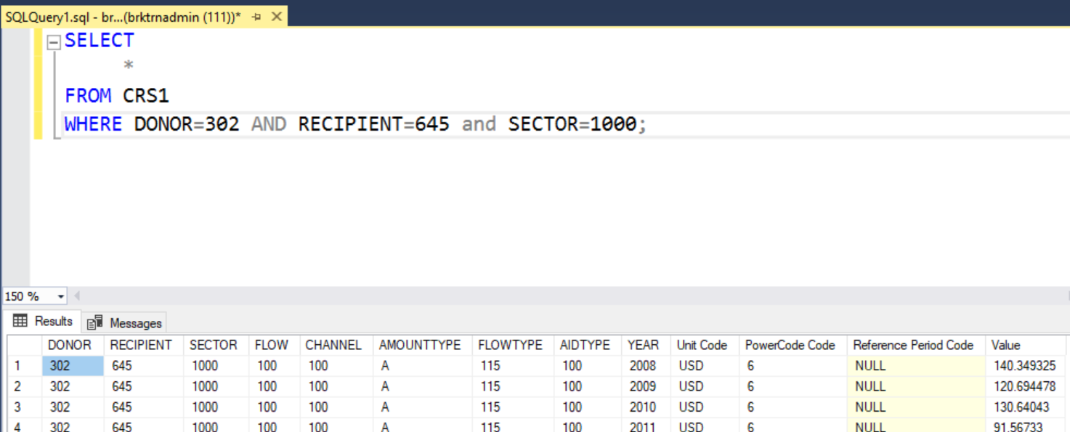
Subset data

Slide 70
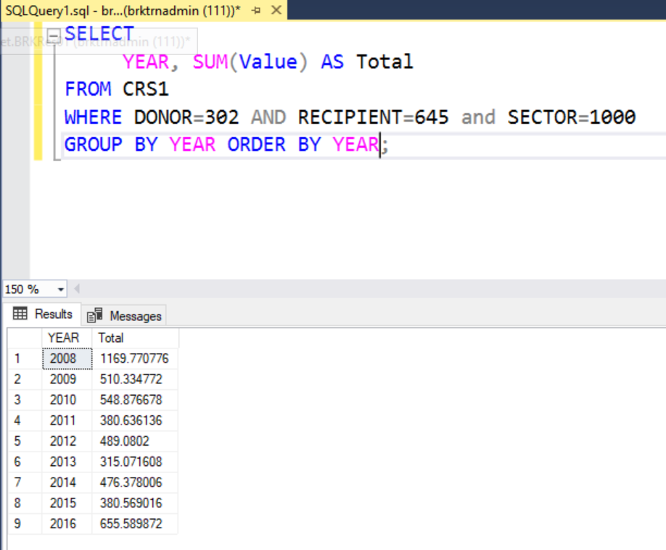
Aggregate by year

Slide 71
We don’t want to do things by hand

Slide 72
Using joins

Slide 73
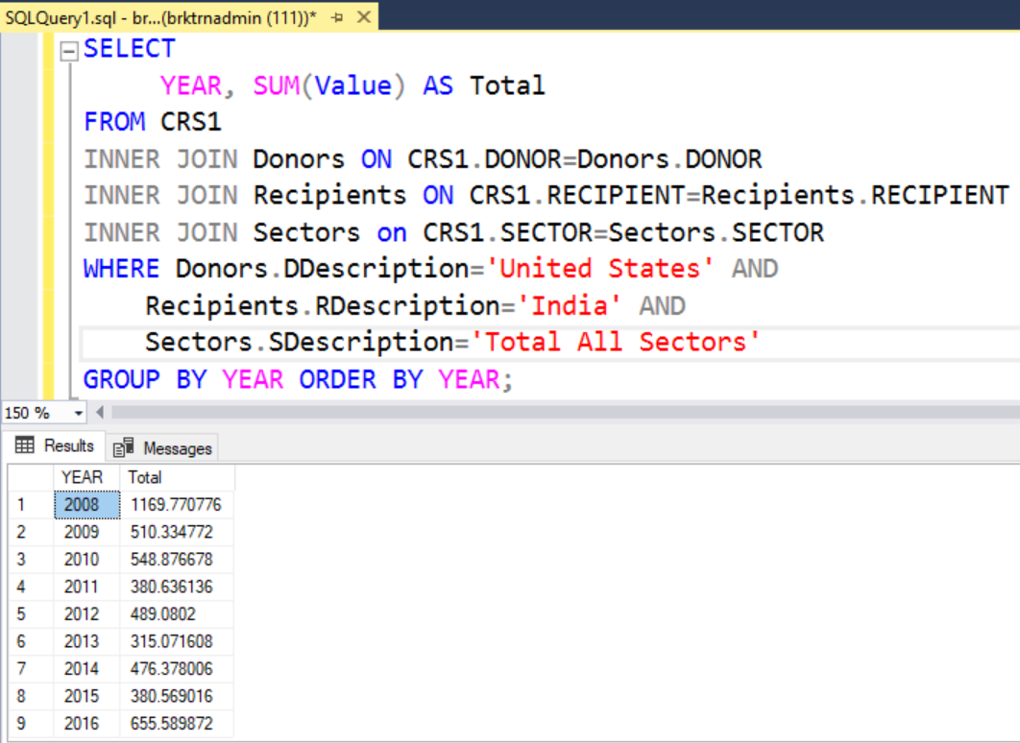

Slide 74
Using Semi joins

Slide 75
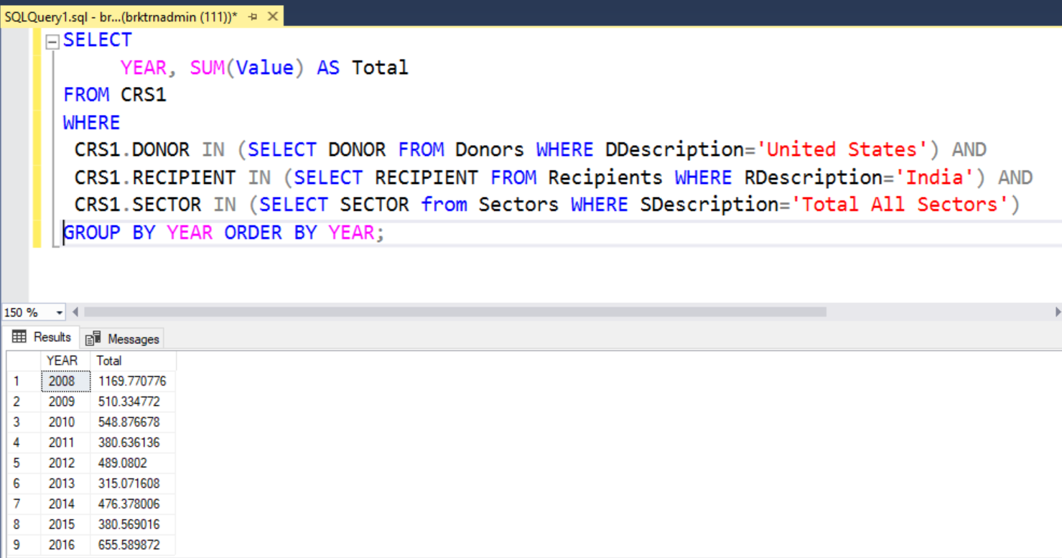

Slide 76
Temporary tables

Slide 77
Querying data from other languages
Reaching SQL Server from R, Python and Stata

Slide 78
Basic idea
Each language has a way to connect to ODBC drivers
R has the odbc package
Python has the pyodbc package
Stata has the odbc command
Once you connect through ODBC, you can pass SQL statements and get the results back into the respective environment

Slide 79
Some integrations
In R
The tidyverse packages provide a R-like syntax and piping that is converted into SQL statements and run in the database. Particularly the dbplyr package
In Python
The pandas package has read_sql_query and to_sql functions which convert between SQL results and the DataFrame object
In Stata
You can directly load the results of a SQL query as a dataset in Stata

Slide 80
Wrapping SQL in R
https://dbplyr.tidyverse.org/
https://db.rstudio.com/

Slide 81
Connecting to the DB
library(odbc)
cnxn <- dbConnect(odbc(),
server="brkressql01.database.windows.net",
driver = "ODBC Driver 17 for SQL Server",
database="BRKRes01",
UID = "<your username>",
PWD = "<your password>")

Slide 82
Basic queries
head(dbListTables(cnxn)) # Show all the tables
dbListFields(cnxn,'Cars’) # Show fields in Cars
D <- dbGetQuery(cnxn, "select * from Cars")
res <- dbSendQuery(cnxn, 'select * from Cars')
d <- dbFetch(res)

Slide 83
A more complex query
# See cash flows from US to India
query <- "SELECT YEAR, SUM(Value) AS Total
FROM CRS1
WHERE
CRS1.DONOR IN (SELECT DONOR FROM Donors WHERE DDescription='United States') AND
CRS1.RECIPIENT IN (SELECT RECIPIENT FROM Recipients WHERE RDescription='India') AND
CRS1.SECTOR IN (SELECT SECTOR from Sectors WHERE SDescription='Total All Sectors’)”
Dat <- dbGetQuery(cnxn, query)

Slide 84
A more complex query
rs <- dbSendQuery(cnxn, query)
dat <- list()
i <- 0
while(!dbHasCompleted(rs)){
i <- i+1
dat[[i]] <- dbFetch(rs, n = 100) # get data in chunks
}
final_dat <- do.call(rbind, dat)
dbClearResult(rs)

Slide 85
Using the tidyverse
library(tidyverse)
crs <- tbl(cnxn,'CRS1')
donors <- tbl(cnxn, 'Donors')
recipients <- tbl(cnxn, 'Recipients')
sectors <- tbl(cnxn, 'Sectors')
D <- crs %>%
semi_join(filter(donors, DDescription=='United States'),by='DONOR') %>%
semi_join(filter(recipients, RDescription=='India'), by='RECIPIENT') %>%
semi_join(filter(sectors, SDescription=='Total All Sectors'), by='SECTOR')
No computation has happened yet!

Slide 86
Using the tidyverse
library(tidyverse)
crs <- tbl(cnxn,'CRS1')
donors <- tbl(cnxn, 'Donors')
recipients <- tbl(cnxn, 'Recipients')
sectors <- tbl(cnxn, 'Sectors')
D <- crs %>%
semi_join(filter(donors, DDescription=='United States'),by='DONOR') %>%
semi_join(filter(recipients, RDescription=='India'), by='RECIPIENT') %>%
semi_join(filter(sectors, SDescription=='Total All Sectors'), by='SECTOR’) %>%
collect(n = Inf)

Slide 87
Using the tidyverse
D <- crs %>%
semi_join(filter(donors, DDescription=='United States'),by='DONOR') %>%
semi_join(filter(recipients, RDescription=='India'), by='RECIPIENT') %>%
semi_join(filter(sectors, SDescription=='Total All Sectors'), by='SECTOR’) %>%
collect(n = Inf)
D %>% group_by(YEAR) %>% summarize(Total = sum(Value)) %>% arrange(YEAR)
YEAR | Total
2008 | 1169.7708
2009 | 510.3348
2010 | 548.8767
2011 | 380.6361
2012 | 489.0802
2013 | 315.0716
2014 | 476.3780
2015 | 380.5690
2016 | 655.5899

Slide 88
Using the tidyverse
You can treat database tables as R data.frame objects
The code gets translated to SQL
Once you “collect”, the data returns to R as a data.frame object
Enjoy R syntax while using a SQL-based database

Slide 89
Wrapping SQL in Python
https://github.com/mkleehammer/pyodbc/wiki

Slide 90
Connecting to the db
import pyodbc
import pandas as pd
config = dict(
driver = '{ODBC Driver 17 for SQL Server}',
server = 'tcp:brkressql01.database.windows.net',
database = 'BRKRes01',
username = '<your username>' ,
password = '<your password>')
conn_str = ('DRIVER={driver};'+
'SERVER={server};'+
'DATABASE={database};'+
'UID={username};'+
'PWD={password}')
cnxn = pyodbc.connect(conn_str.format(**config))

Slide 91
Connecting to the db
import pyodbc
import pandas as pd
config = dict(
driver = '{ODBC Driver 17 for SQL Server}',
server = 'tcp:brkressql01.database.windows.net',
database = 'BRKRes01',
username = '<your username>' ,
password = '<your password>')
conn_str = ('DRIVER={driver};'+
'SERVER={server};'+
'DATABASE={database};'+
'UID={username};'+
'PWD={password}')
cnxn = pyodbc.connect(conn_str.format(**config))
In Python, + does string concatenation

Slide 92
Basic operations
cursor = cnxn.cursor()
cursor.execute("select top 10 * from CRS1;")
cursor.fetchall()

Slide 93
Basic operations
Concept of a cursor that runs things
Have to explicitly fetch results
cursor = cnxn.cursor()
cursor.execute("select top 10 * from CRS1;")
cursor.fetchall()

Slide 94
More complex queries
query = '''SELECT
YEAR, SUM(Value) AS Total
FROM CRS1
WHERE
CRS1.DONOR IN (SELECT DONOR FROM Donors WHERE DDescription='United States') AND
CRS1.RECIPIENT IN (SELECT RECIPIENT FROM Recipients WHERE RDescription='India') AND
CRS1.SECTOR IN (SELECT SECTOR from Sectors WHERE SDescription='Total All Sectors')
GROUP BY YEAR ORDER BY YEAR;'''
test = pd.read_sql(query, cnxn)

Slide 95
More complex queries
query = '''SELECT
YEAR, SUM(Value) AS Total
FROM CRS1
WHERE
CRS1.DONOR IN (SELECT DONOR FROM Donors WHERE DDescription='United States') AND
CRS1.RECIPIENT IN (SELECT RECIPIENT FROM Recipients WHERE RDescription='India') AND
CRS1.SECTOR IN (SELECT SECTOR from Sectors WHERE SDescription='Total All Sectors')
GROUP BY YEAR ORDER BY YEAR;'''
test = pd.read_sql(query, cnxn) # This uses pandas to store into a DataFrame
So you’re basically just passing SQL statements to the DB through Python

Slide 96
Wrapping sql in stata
https://www.stata.com/meeting/portugal15/abstracts/materials/portugal15_sousa.pdf

Slide 97
Connecting to the db
clear
set more off
odbc list
odbc query, connectionstring("DSN=SQLBrookings;Database=BRKRes01;") u("<your username>")
p("<your password>")
You need a DSN for Stata to work
Stata odbc doesn’t work well outside Windows

Slide 98
Loading a table into stata
/* Load a table from the database */
local connstr "DSN=SQLBrookings;Database=BRKRes01;"
odbc load , table("Donors") connectionstring("`connstr'") clear

Slide 99
Running a more complex query
/* Execute a more complicated query and load the resultant table in Stata */
local connstr "DSN=SQLBrookings;Database=BRKRes01;"
local query1 "SELECT YEAR, SUM(Value) AS Total FROM CRS1 WHERE CRS1.DONOR IN (SELECT DONOR FROM Donors WHERE DDescription='United States') AND CRS1.RECIPIENT IN (SELECT RECIPIENT FROM Recipients WHERE RDescription='India') AND CRS1.SECTOR IN (SELECT SECTOR from Sectors WHERE SDescription='Total All Sectors') GROUP BY YEAR ORDER BY YEAR;"
odbc load , exec("`query1'") clear connectionstring("`connstr'")
list

Slide 100
Programming vs db
All the functionality in SQL is available in the languages
However, merging/joining and aggregation can be easier, and faster, in SQL
Merging, specially multiple data sets, is a bit of a mess in Stata
Merging is a lot better in R using tidyverse or data.table
Merging is a lot better in Python using Pandas
If your datasets can fit in memory, you’re probably better off programming
Caveat is if you need multiple joins; SQL is better there

Slide 101
Programming vs db
DBs and SQL are only doing data manipulation and munging
You still need programming, or other software, for analytics and visualization
Some Enterprise-level DBs, like Oracle and SAP, now allow R/Python scripting witin the DB without the SQL translation layer

Slide 102
Programming vs db
If you have large, complex data, using a DB with a good structure is worth it in terms of time and effort

Slide 103
Loading data into the db

Slide 104
Loading data into the db
You’re not going to go the CREATE TABLE route.
There are nice import wizards in SSMS
I find it easier to load datasets using the programming languages, if each individual table is not too big

Slide 105
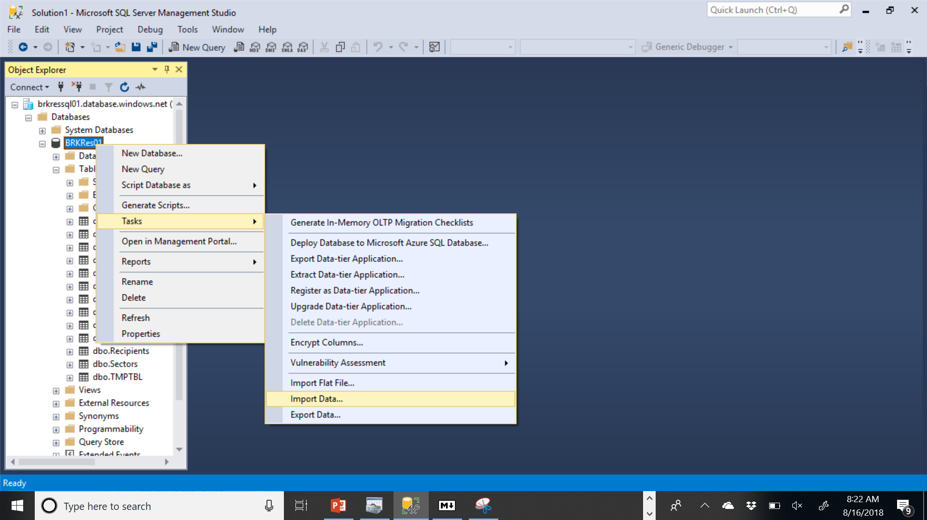
Loading data into the db

Slide 106
Loading data into the db
You can use SSMS to load data into a SQL Server DB from Excel, Access or flat files (csv/tsv)

Slide 107
Loading data into the db using R
library(odbc)
cnxn <- dbConnect(odbc(), server="brkressql01.database.windows.net",
driver = "ODBC Driver 17 for SQL Server",
database="BRKRes01",
UID = "<your username>",
PWD = "<your password>")
dbWriteTable(cnxn, 'CRS1',CRS1, overwrite=T, temporary=F)

Slide 108
Loading data into the db using R
library(odbc)
cnxn <- dbConnect(odbc(), server="brkressql01.database.windows.net",
driver = "ODBC Driver 17 for SQL Server",
database="BRKRes01",
UID = "<your username>",
PWD = "<your password>")
dbWriteTable(cnxn, 'CRS1',CRS1, overwrite=T, temporary=F)
Connection
Table name in DB
Object in R

Slide 109
Loading data into the db using python
import seaborn as sns
iris = sns.load_dataset('iris’)
import sqlalchemy
import urllib
params = urllib.parse.quote_plus(conn_str.format(**config))
engine = sqlalchemy.create_engine("mssql+pyodbc:///?odbc_connect={}".format(params),
echo=False)
iris.to_sql('Iris', engine, if_exists='replace', index = False)

Slide 110
Loading data into the db using python
import seaborn as sns
iris = sns.load_dataset('iris’) # Grab dataset from R
import sqlalchemy
import urllib
params = urllib.parse.quote_plus(conn_str.format(**config)) # Set up access to DB
engine = sqlalchemy.create_engine("mssql+pyodbc:///?odbc_connect={}".format(params),
echo=False) # Uploading using pandas requires SQLAlchemy engine
iris.to_sql('Iris', engine, if_exists='replace', index = False)
DataFrame in Python
Table name in DB

Slide 111
Loading data into DB in stata
/* Uploading your own data */
sysuse auto.dta, clear
local connstr "DSN=SQLBrookings;Database=BRKRes01;"
odbc insert make price mpg rep78 displacement gear_ratio, table("Auto")
connectionstring("`connstr'") create sql

Slide 112
Loading data into DB in stata
/* Uploading your own data */
sysuse auto.dta, clear
local connstr "DSN=SQLBrookings;Database=BRKRes01;"
odbc insert make price mpg rep78 displacement gear_ratio, table("Auto")
connectionstring("`connstr'") create sql
Replace create with replace to overwrite SQL tables

